Slide 1
Quark Version 2 Designs

Slide 2
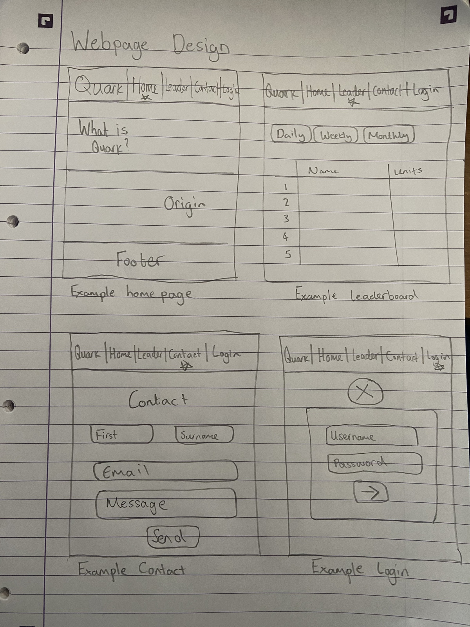
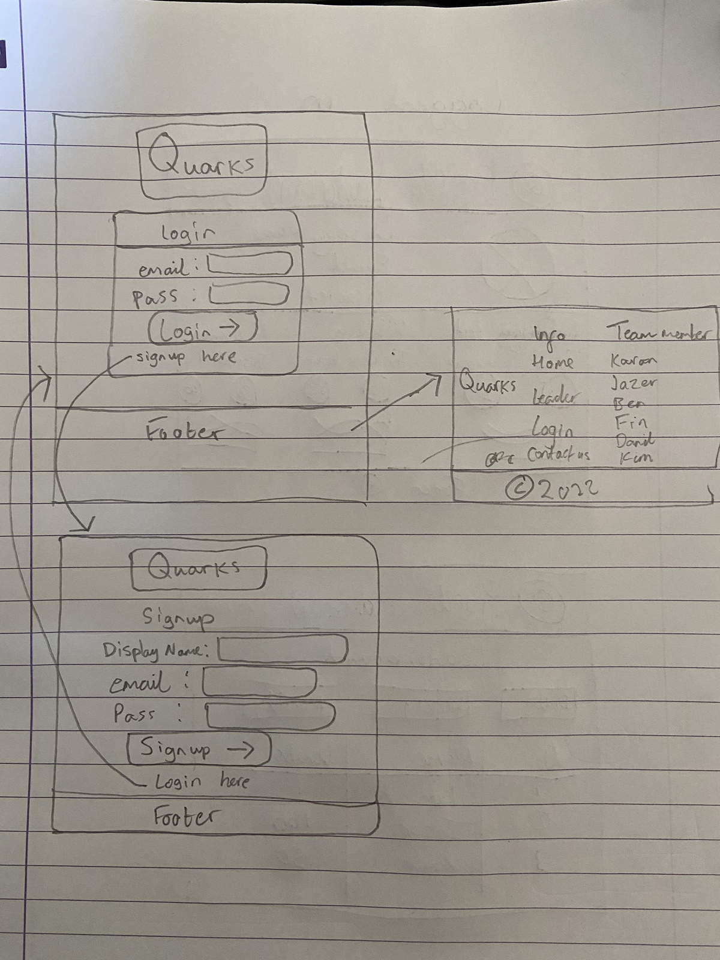

Slide 3
